Slide 1
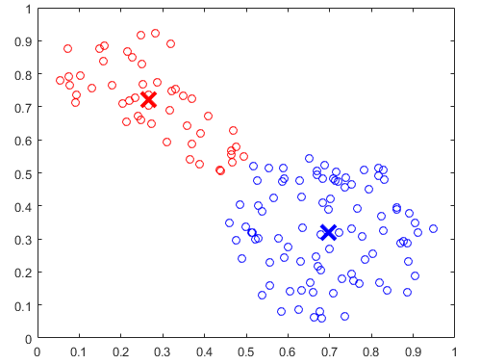
Clustring
Fuzzy c-means (FCM) is a clustering method that allows each data point to belong to multiple clusters with varying degrees of membership.
Frequently used in pattern
recognition

Slide 2
Fuzzy- C Mean Clustring Method
This algorithm works by assigning membership to each data point corresponding to each cluster center on the basis of distance between the cluster center and the data point.
Algorithmic Steps:
1). Randomly select ‘c’ cluster centers.
2). Calculate the fuzzy membership
3). Compute the fuzzy centers
4). Repeat step 2) and until the minimum objective function value is achieved

Slide 3
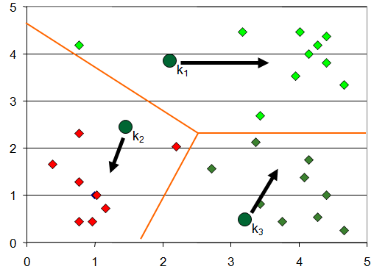
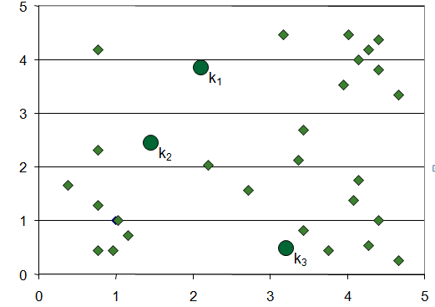
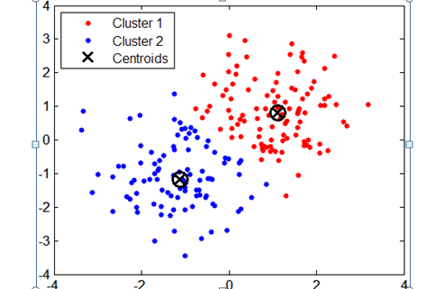
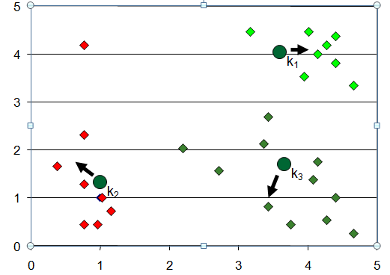

Slide 4
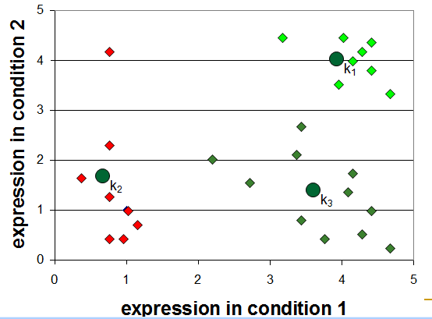

Slide 5
Advantages nad Disavantages
Advantages 1) Gives best result for overlapped data set and comparatively better then k-means algorithm. 2) Unlike k-means where data point must exclusively belong to one cluster center here data point is assigned membership to each cluster center as a result of which data point may belong to more then one cluster center. Disadvantages 1) Apriori specification of the number of clusters. 2) With lower value of β we get the better result but at the expense of more number of iteration. 3) Euclidean distance measures can unequally weight underlying factors.

